Slide 1
Database Scaling: Replication and Sharding

Slide 2
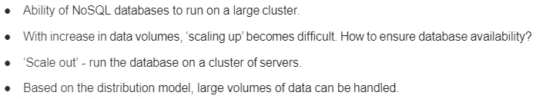

Managing database for availability and performance

Slide 3
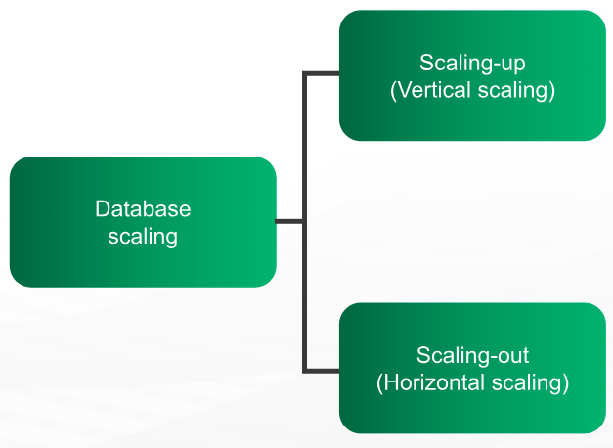
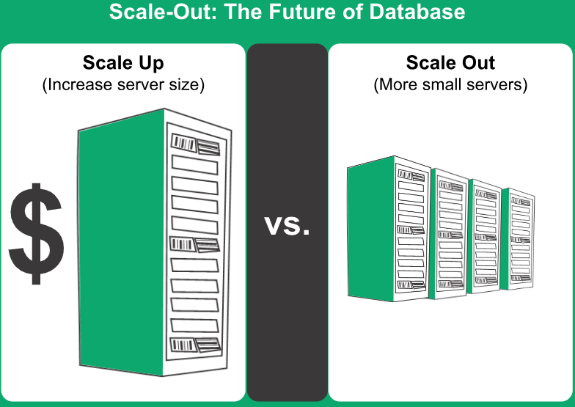
Database Scaling
Scaling-up/Vertical scaling: means upgrading a server, by means of adding more memory, faster processor, or larger storage devices. Adding more hardware can help increase the amount of traffic a server can support and the amount of data it can process in a reasonable period of time.
Scaling-out/Horizontal scaling: means adding more servers to the task. Though, this is complex process, this helps in increasing the capacity to a great extent. In one way, the additional servers act as backup devices and play their role when the main server fails. In other ways, work and network traffic can be shared between all the servers. When many servers are added to the task, the group of machines assigned to a particular task is called as cluster.

Slide 4
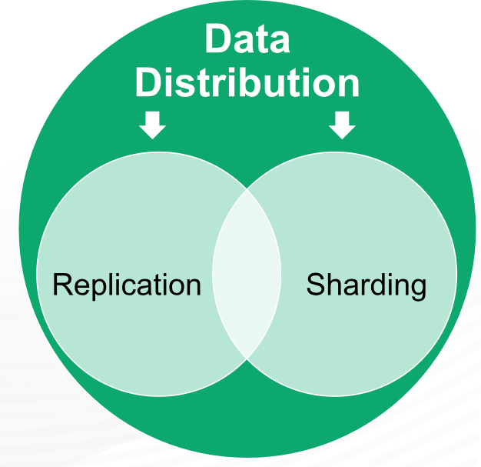
Database Distribution Models
Replication: Same data is copied on multiple servers.
Sharding: Data is put on multiple nodes.

Slide 5
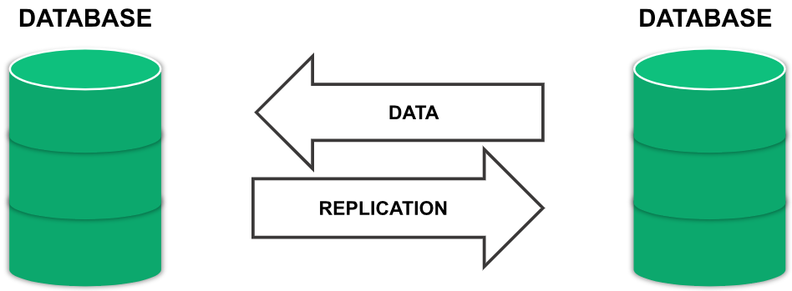
Data Replication
Process of keeping the data synced.
Complete copy of database on a different server.
When the primary server fails, the backup server will come online and take the responsibility.
Reduced downtime compared to fixing failures manually
System automatically detects failures and activate backup machines.

Slide 6
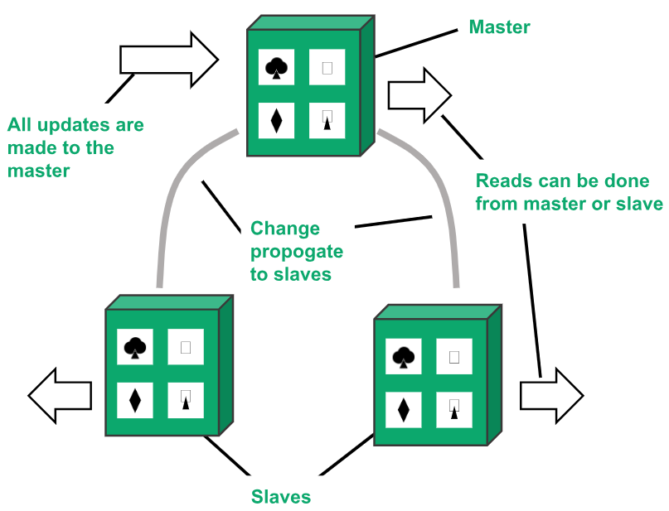
Types of database replication
1. Master-slave replication:
One master or primary node and others are slaves.
Master is the primary source of data and designed to process updates and send to slaves.
Slaves are used for read operation.
Used for read-intensive datasets.
Horizontal scaling possible by adding more slaves.
Masters can be appointed manually and automatically.

Slide 7
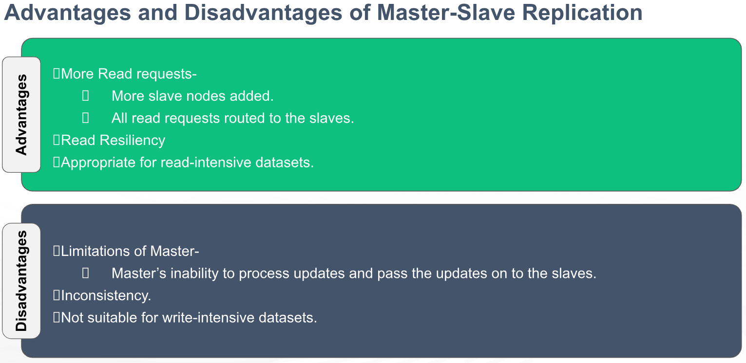

Slide 8
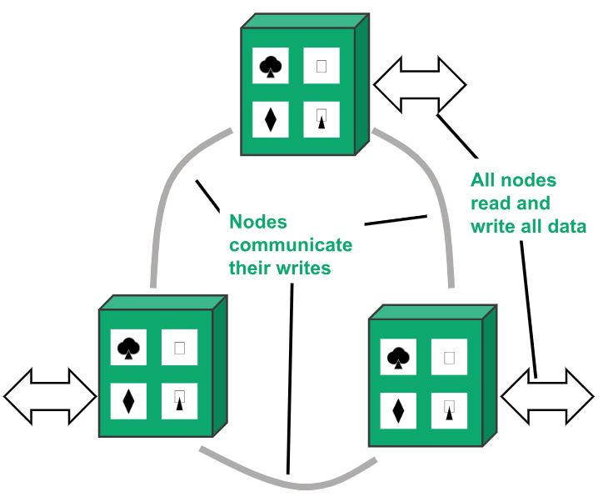
2. Peer-to-Peer Replication:
Very useful for improving the ‘write’ scalability that is not offered by master-slave replication.
There is no master and no single point of failure.
All the replicas are equal and accept the writes and reads.
More nodes can be added for performance improvement.

Slide 9
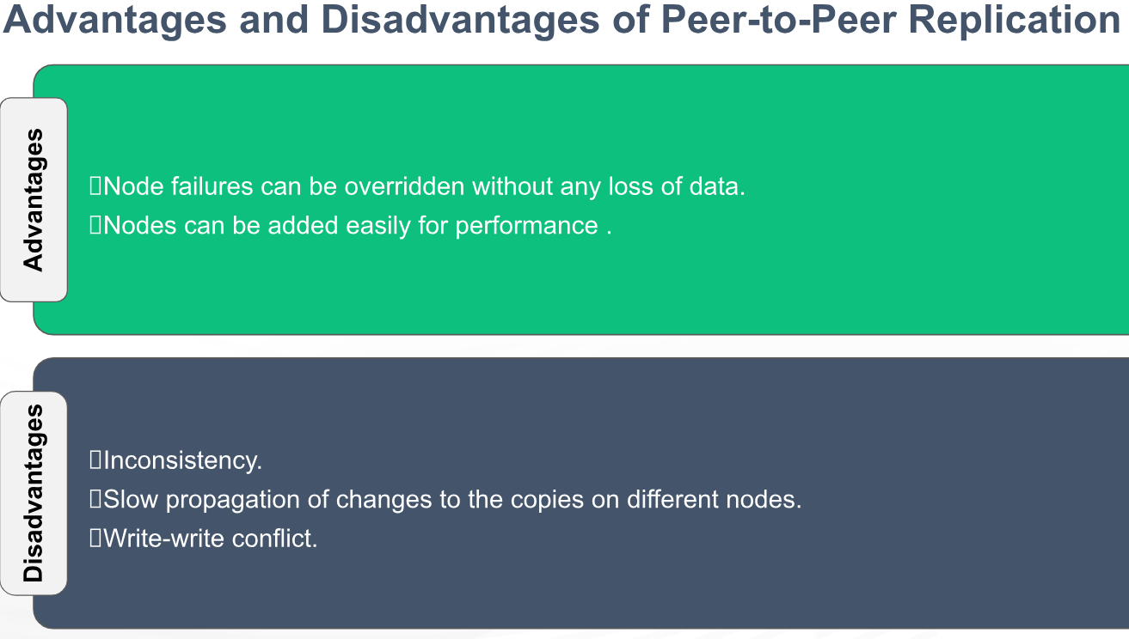

Slide 10
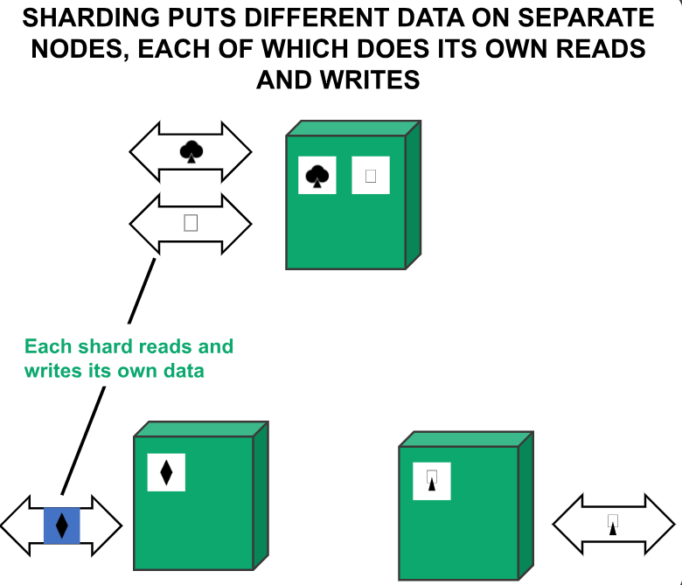
Introduction to Sharding
Sharding is a method for distributing data across multiple machines.
Defined as “shared-nothing” partitioning schema for large databases across a number of servers.
Method of splitting and storing a single logical dataset in multiple databases.
MongoDB uses sharding to support deployments with very large data sets and high throughput operations.
Optimization technique to achieve horizontal scaling in DB.
Database systems with large data sets or high throughput applications can challenge the capacity of a single server.

Slide 11
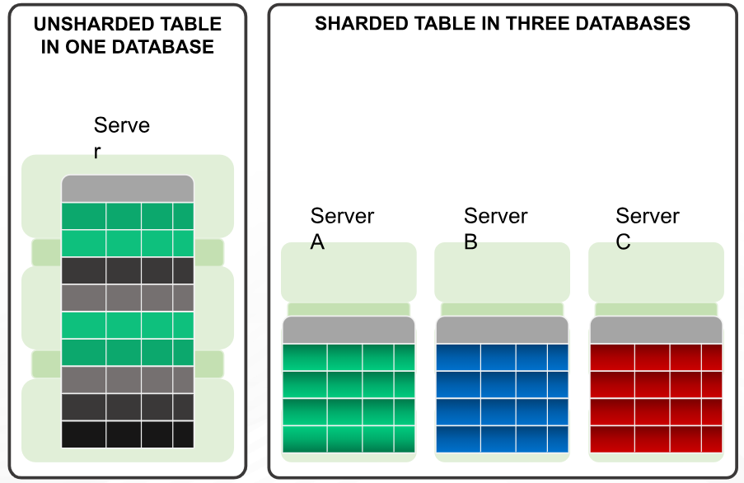
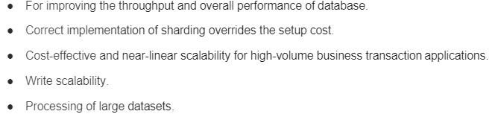
Why Sharding?

Slide 12
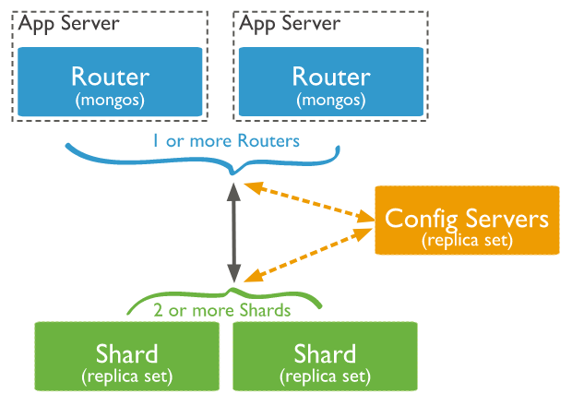
Sharding components
Shard: A shard is a single MongoDB instance that holds a subset of the sharded data. Shards can be deployed as replica sets to increase availability and provide redundancy. The combination of multiple shards creates a complete data set. For example, a 2 TB data set can be broken down into four shards, each containing 500 GB of data from the original data set.
Mongos: Mongos act as the query router providing a stable interface between the application and the sharded cluster. This MongoDB instance is responsible for routing the client requests to the correct shard.
Config Servers: Configuration servers store the metadata and the configuration settings for the whole cluster.
The application communicates with the routers (mongos) about the query to be executed.
The mongos instance consults the config servers to check which shard contains the required data set to send the query to that shard.
Finally, the result of the query will be returned to the application.

Slide 13
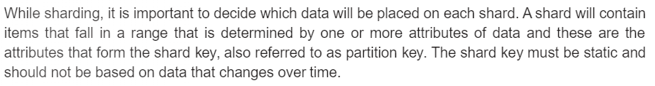
How Sharding works?
How will the data be distributed across shards? A data store is divided into horizontal partitions or shards. A shard is a data store in its on way, running on a server, acting as a storage node.
Definitions
Shard or partition Key: MongoDB uses the shard key to distribute the collection's documents across shards.
The shard key consists of a field or multiple fields in the documents.
The shard key is either a single indexed field or multiple fields covered by a compound index that determines the distribution of the collection's documents among the cluster's shards.
Logical Shard: is the collection of data that share the same partition key.
Physical Shard: also referred to, a database node, a physical shard is a collection of logical shards.

Slide 14
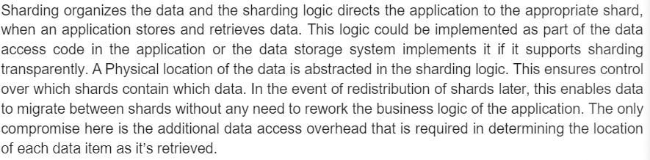
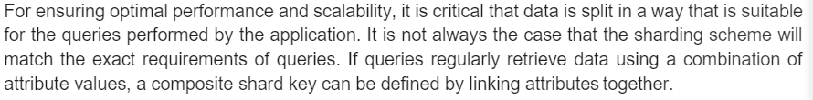

Slide 15
Shard key
When sharding a MongoDB collection, a shard key gets created as one of the initial steps.
The “shard key” is used to distribute the MongoDB collection’s documents across all the shards.
The key consists of a single field or multiple fields in every document.
The sharded key is immutable and cannot be changed after sharding. A sharded collection only contains a single shard key.
The shard key can directly have an impact on the performance of the cluster. Hence can lead to bottlenecks in applications associated with the cluster.
To mitigate this, before sharding the collection, the shard key must be created based on:
The schema of the data set
How the data set is queried

Slide 16
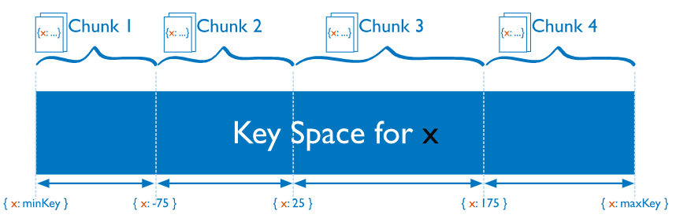
Chunks: Chunks are subsets of shared data. MongoDB separates sharded data into chunks that are distributed across the shards in the shared cluster. Each chunk has an inclusive lower and exclusive upper range based on the shard key. A balancer specific for each cluster handles the chunk distribution.
The balancer runs as a background job and distributes the chunks as needed to achieve an even balance of chunks across all shards. This process is called even chuck distribution.

Slide 17
Choose a Shard Key
The choice of shard key affects the creation and distribution of chunks across the available shards. The distribution of data affects the efficiency and performance of operations within the sharded cluster.
The ideal shard key allows MongoDB to distribute documents evenly throughout the cluster while also facilitating common query patterns.
When you choose your shard key, consider:
The cardinality of the shard key: The cardinality of a shard key determines the maximum number of chunks the balancer can create. Where possible, choose a shard key with high cardinality. A shard key with low cardinality reduces the effectiveness of horizontal scaling in the cluster.
The frequency with which shard key values occur: The frequency of the shard key represents how often a given shard key value occurs in the data. If the majority of documents contain only a subset of the possible shard key values, then the chunks storing the documents with those values can become a bottleneck within the cluster.
Sharding Query Patterns: consider your most common query patterns and whether a given shard key covers them.
You should not choose a key which frequently changes.

Slide 18
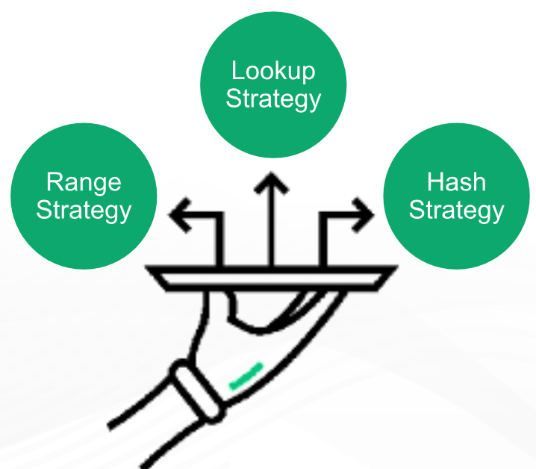
Sharding strategies
There are three major strategies commonly used when selecting the shard key and distributing the data across shards.

Slide 19
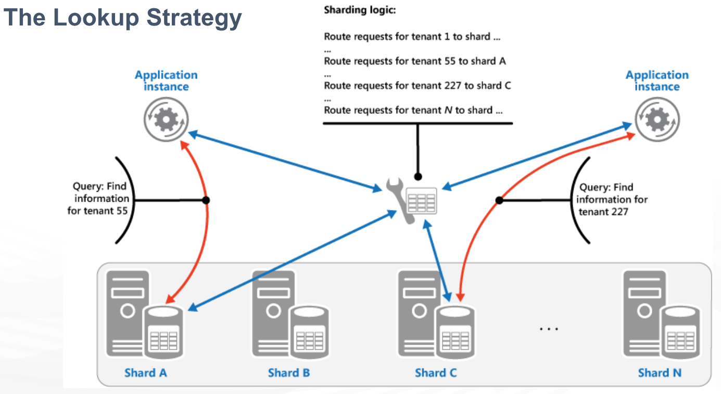
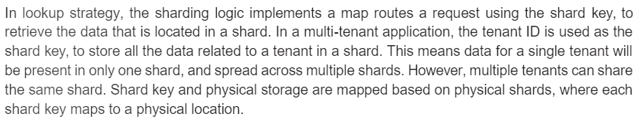

Slide 20
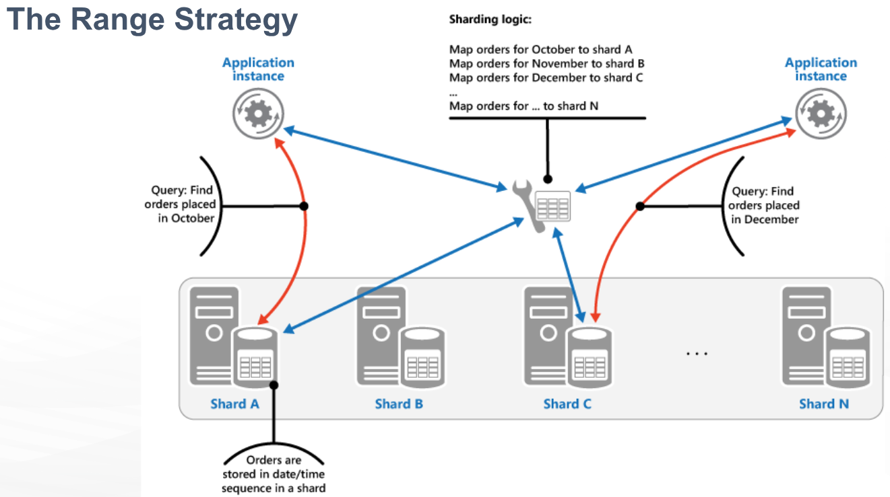

Slide 21
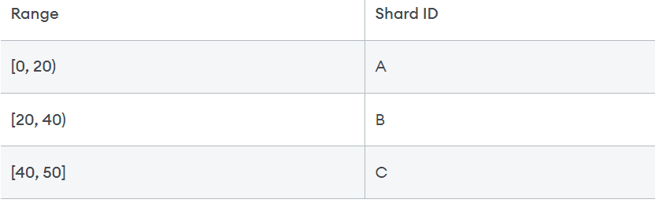
Ranged sharding, or dynamic sharding, takes a field on the record as an input and, based on a predefined range, allocates that record to the appropriate shard. Ranged sharding requires there to be a lookup table or service available for all queries or writes. For example, consider a set of data with IDs that range from 0-50. A simple lookup table might look like the following:
The field on which the range is based is also known as the shard key. Naturally, the choice of shard key, as well as the ranges, are critical in making range-based sharding effective. A poor choice of shard key will lead to unbalanced shards, which leads to decreased performance. An effective shard key will allow for queries to be targeted to a minimum number of shards. In our example above, if we query for all records with IDs 10-30, then only shards A and B will need to be queried.

Slide 22
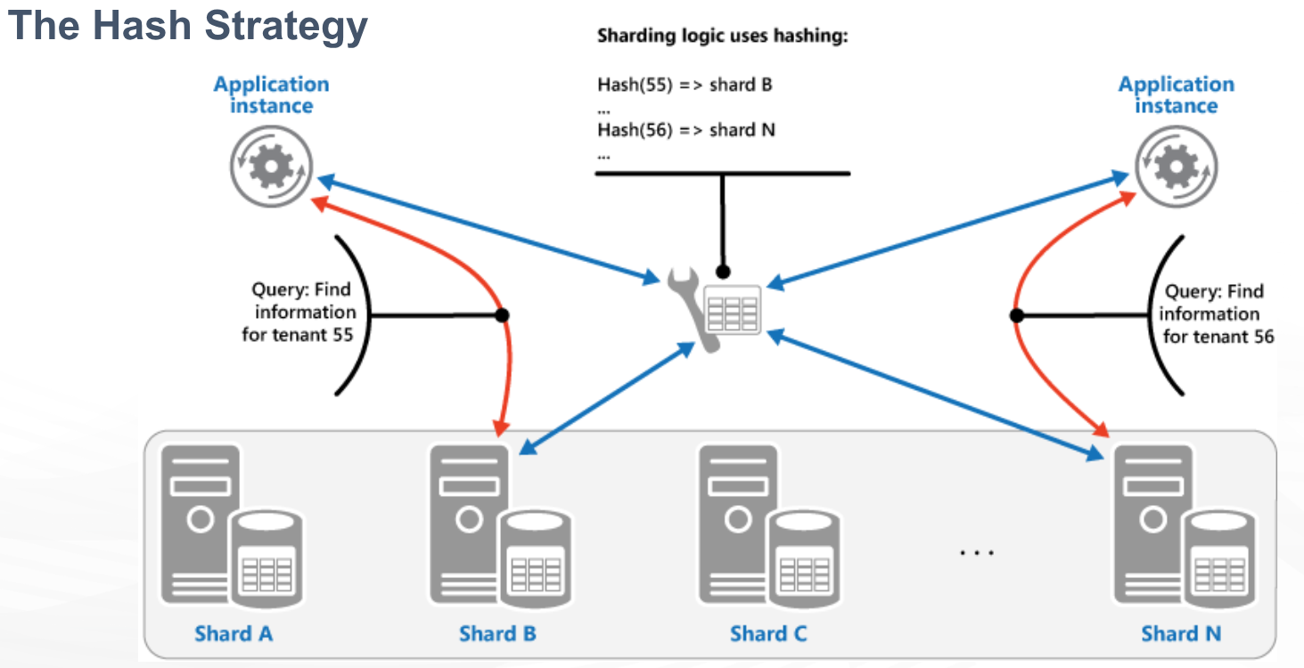
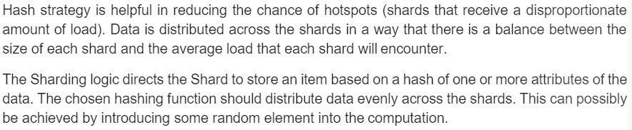

Slide 23
Algorithmic sharding or hashed sharding, takes a record as an input and applies a hash function or algorithm to it which generates an output or hash value. This output is then used to allocate each record to the appropriate shard.
The function can take any subset of values on the record as inputs. Perhaps the simplest example of a hash function is to use the modulus operator with the number of shards, as follows:
Hash Value=ID % Number of Shards
This is similar to range-based sharding — a set of fields determines the allocation of the record to a given shard. Hashing the inputs allows more even distribution across shards even when there is not a suitable shard key, and no lookup table needs to be maintained. However, there are a few drawbacks.
First, query operations for multiple records are more likely to get distributed across multiple shards. Whereas ranged sharding reflects the natural structure of the data across shards, hashed sharding typically disregards the meaning of the data. This is reflected in increased broadcast operation occurrence.
Second, resharding can be expensive. Any update to the number of shards likely requires rebalancing all shards to moving around records. It will be difficult to do this while avoiding a system outage.

Slide 24
Advantages of Sharding
Reads / Writes: MongoDB distributes the read and write workload across the shards in the sharded cluster, allowing each shard to process a subset of cluster operations.
Both read and write workloads can be scaled horizontally across the cluster by adding more shards.
Storage Capacity: Sharding distributes data across the shards in the cluster, allowing each shard to contain a subset of the total cluster data.
As the data set grows, additional shards increase the storage capacity of the cluster.
High Availability: If one or more shard replica sets become completely unavailable, the sharded cluster can continue to perform partial reads and writes.
That is, while data on the unavailable shard(s) cannot be accessed, reads or writes directed at the available shards can still succeed.

Slide 25
Disadvantages of sharding
Query overhead: Each sharded database must have a separate machine or service which understands how to route a querying operation to the appropriate shard. This introduces additional latency on every operation.
Furthermore, if the data required for the query is horizontally partitioned across multiple shards, the router must then query each shard and merge the result together. This can make an otherwise simple operation quite expensive and slow down response times.
Complexity of administration: With a single unsharded database, only the database server itself requires upkeep and maintenance. With every sharded database, on top of managing the shards themselves, there are additional service nodes to maintain.
Increased infrastructure costs: Sharding by its nature requires additional machines and compute power over a single database server.
While this allows your database to grow beyond the limits of a single machine, each additional shard comes with higher costs.
The cost of a distributed database system, especially if it is missing the proper optimization, can be significant.

Slide 26
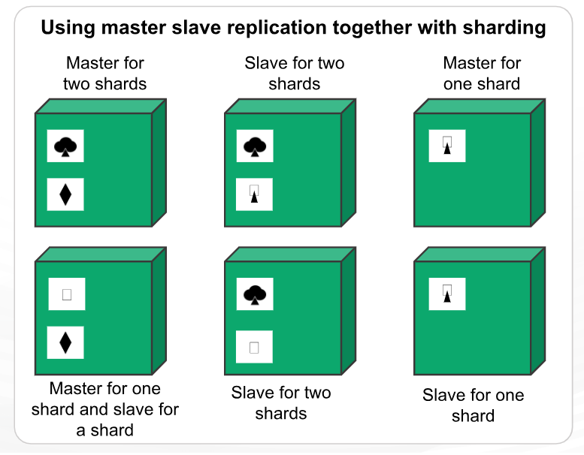
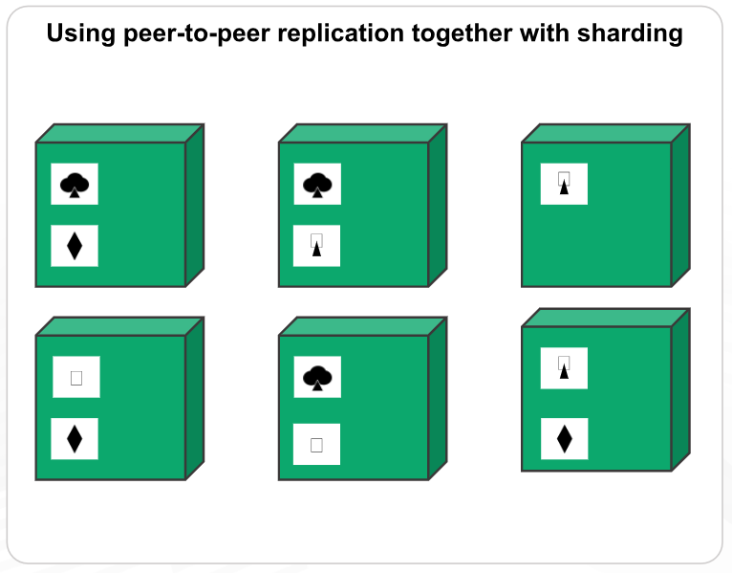
Combining Replication and Sharding
With a combination of Master-slave replication and sharding, we can have multiple masters, but each data item can have only one master. Based on the configuration, we can choose a node to be the master for some data and slaves for others.
Using peer-to-peer replication and sharding, there will be tens or hundreds of nodes will be there in a cluster with data shared over them.

